Slide 1
SE 6387 – Advanced Software Engineering Project
CometPark
Arunkumar Manickam
Hariprasad Natarajan
Prasanna Venkatesh Venkitasamy
Rekha Muthulakshmi Nachadalingam

Slide 2
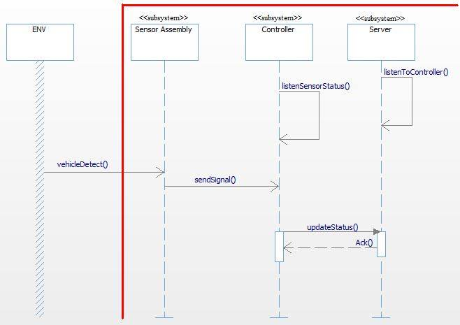
SSD-Update Parking Spot Status

Slide 3
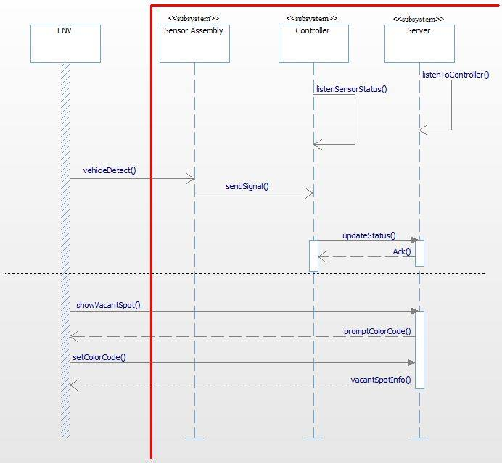
SSD- Find Vacant Parking Spot

Slide 4
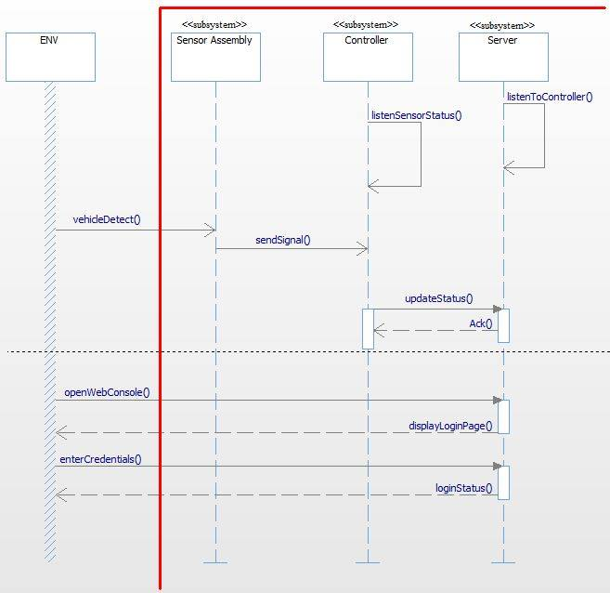
SSD- Login

Slide 5
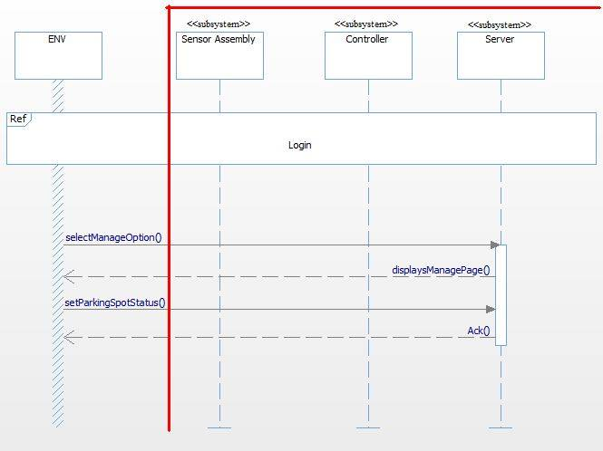
SSD-Manage Parking Spot

Slide 6
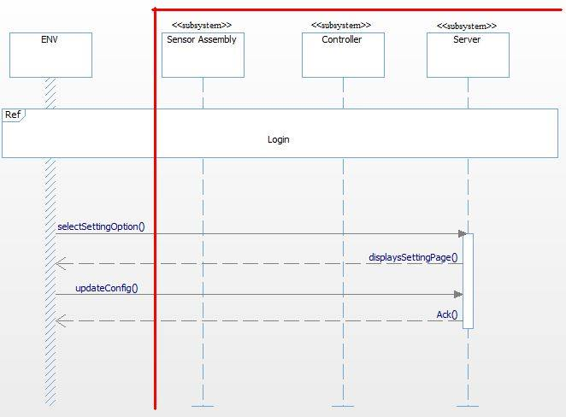
SSD- Update System Config

Slide 7
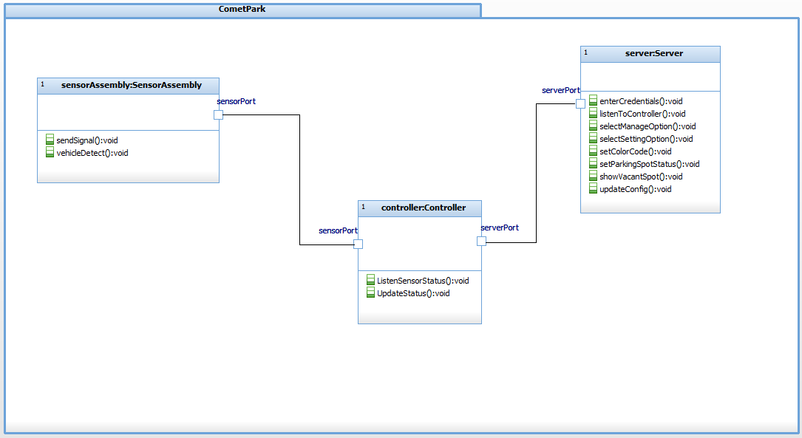
System Architecture

Slide 8
THANK YOU !

